Slide 1
Mini Course: R package development (I)
Rafael Ayala

Slide 2
Background
CRAN packages
Bioconductor packages
NutrienTrackeR (nutrition)
openSkies (aircraft tracking)
asteRisk (astrodynamics)
MetaboSignal (networks)
MWASTools (MWAS)
rfaRm (non-coding RNA)
ncRNAtools (non-coding RNA)

Slide 3
Outline
Day 1: R package structure and CRAN submissions
Day 2: Bioconductor; continuous integration and deployment with GitHub
Day 3: package documentation and advanced features

Slide 4
Day 1
Introduction
Mainstream repositories for R packages
Features and structure of an R package
Submitting a package to CRAN
Practical: creating a package

Slide 5
What is an R package?
Basic unit of shareable code in R
Not just a collection of functions
Provides well documented, tested and reproducible code
Promote reusability and integration of available code
Usually, provide novel methods or implementations
Enable collaborative and modular developments

Slide 6
Package distribution
Internal distribution
GitHub
Publication-quality repositories:
Non-trivial contributions
Active maintenance

Slide 7
Day 1
Introduction
Mainstream repositories for R packages
Features and structure of an R package
Submitting a package to CRAN
Practical: creating a package

Slide 8
Mainstream repositories
Two main R package repositories: CRAN and Bioconductor
CRAN: general purpose, packages for almost any field
Bioconductor: focused on genomics/high-throughput biological assays
Both undergo a formal review of code quality and require novelty in the contribution
Interoperability between packages of the two repositories is ensured
Open-source licenses, most frequently without any use restriction

Slide 9
Mainstream repositories
A package in CRAN/Bioconductor can by itself be considered as a publication
Additionally, good starting point for writing an associated paper.
The R Journal
The Journal of Statistical Software
Bioinformatics Application Note

Slide 10
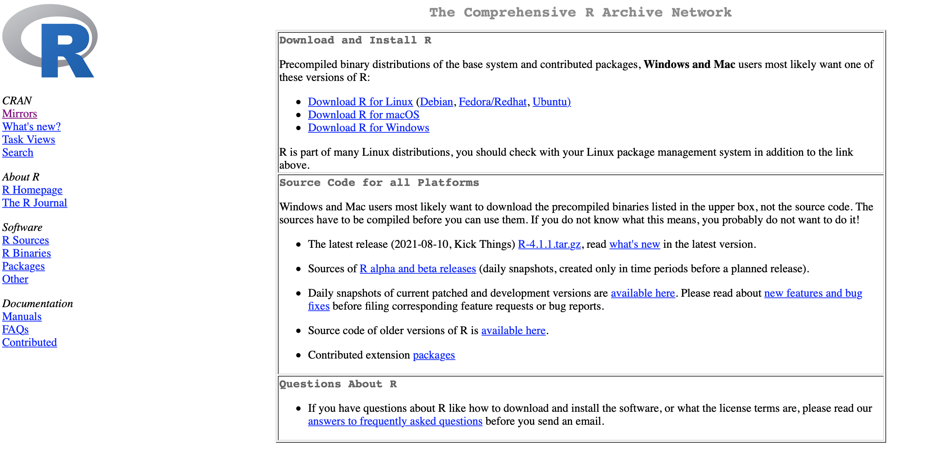
CRAN
Maintained by part of the R Development Core Team
https://cran.r-project.org

Slide 11
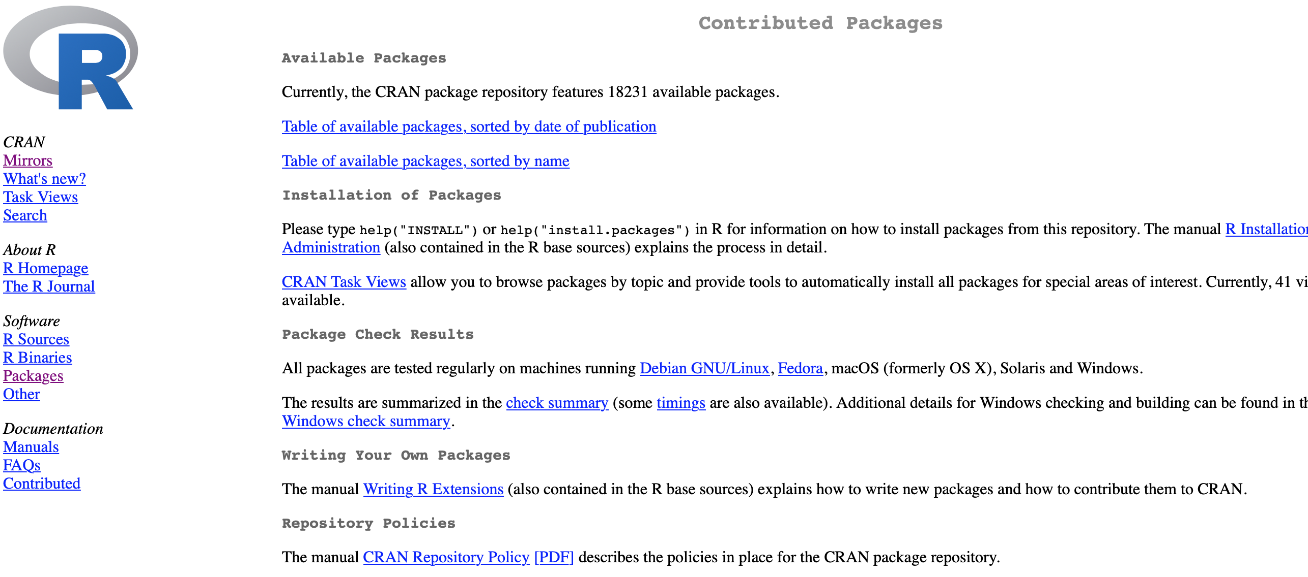
CRAN
Over 18,000 packages

Slide 12
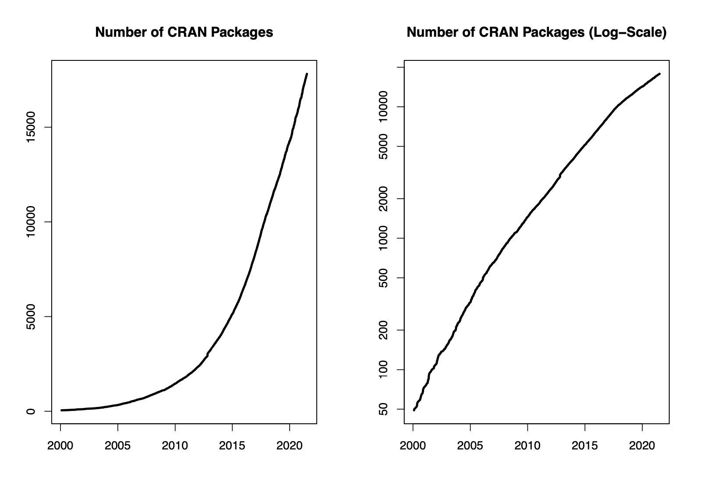
CRAN

Slide 13

Bioconductor
Maintained by the Bioconductor Core Team
http://bioconductor.org

Slide 14
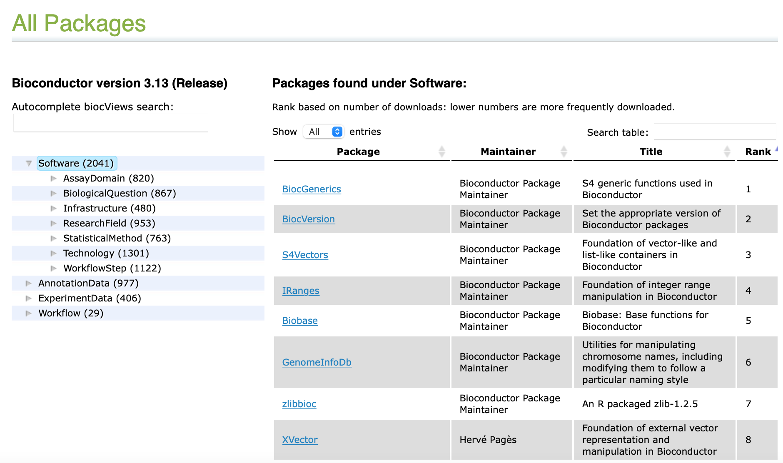
Bioconductor
Originally focused on genomics, now extended to a wider range of biological data

Slide 15
CRAN/Bioconductor
Publication in CRAN/Bioconductor greatly increases visibility
But the package must be actively maintained
Making appropriate changes to accommodate changes in R and, most frequently, on other packages on which your package depends
Updating package to accommodate changes in the underlying employed resources
Updating package to correct bugs reported by users

Slide 16
Maintaining published packages
Publication in CRAN/Bioconductor greatly increases visibility
But the package must be actively maintained
Making appropriate changes to accommodate changes in R and, most frequently, on other packages on which your package depends
Updating package to accommodate changes in the underlying employed resources
Updating package to correct bugs reported by users
Ideally, new/improved features are added progressively

Slide 17
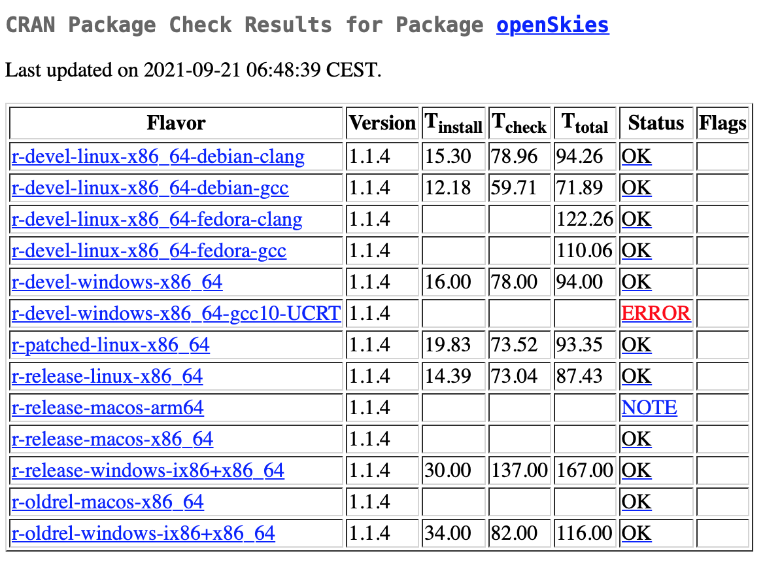
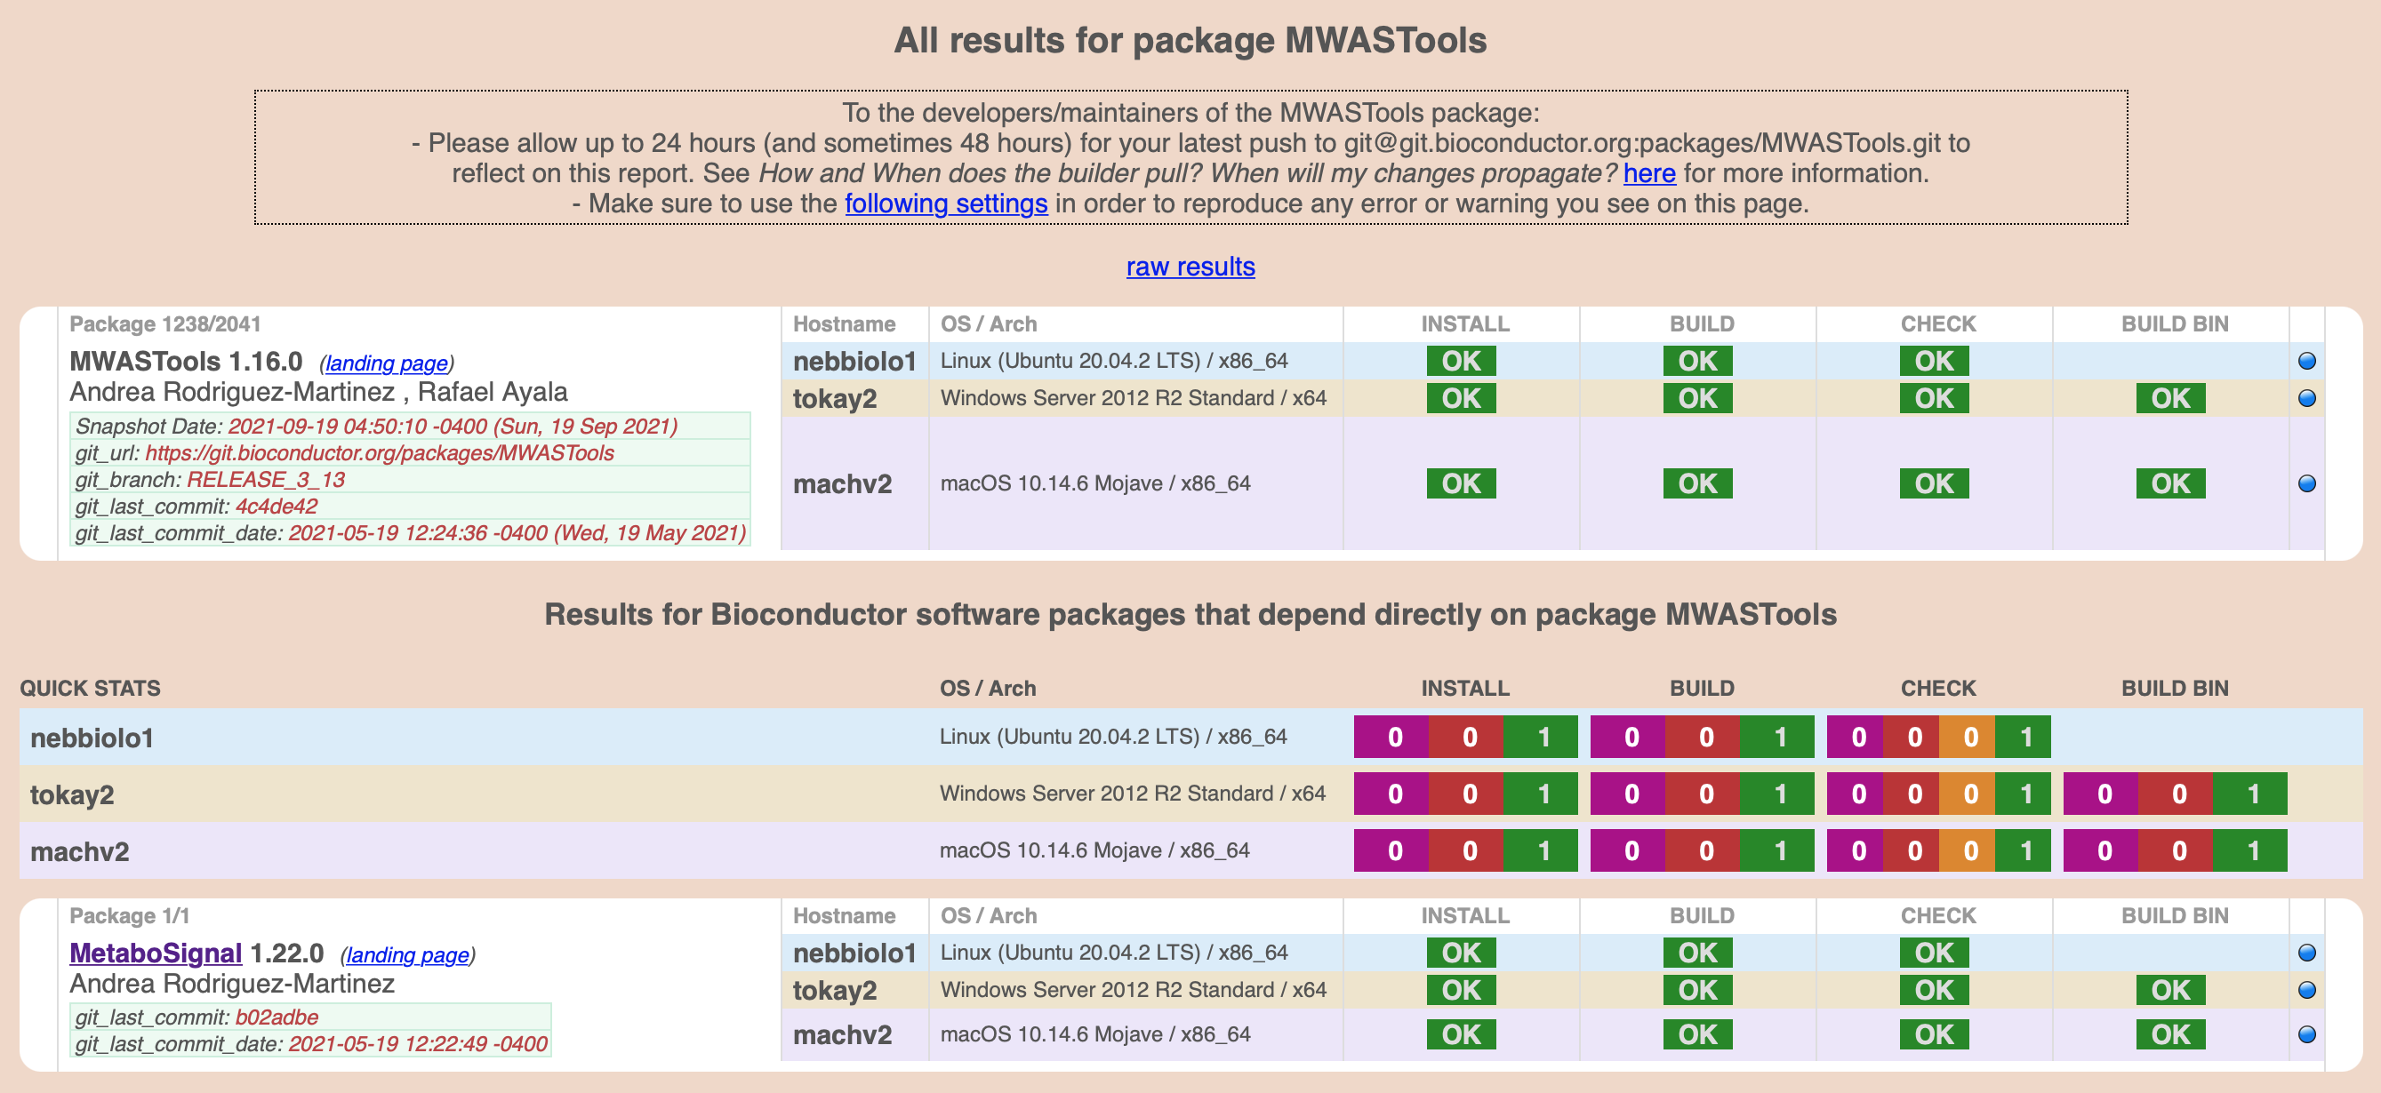
Maintaining published packages
Both repositories perform regular checks on packages
If errors are not corrected, packages will be archived/deprecated

Slide 18
Day 1
Introduction
Mainstream repositories for R packages
Features and structure of an R package
Submitting a package to CRAN
Practical: creating a package

Slide 19
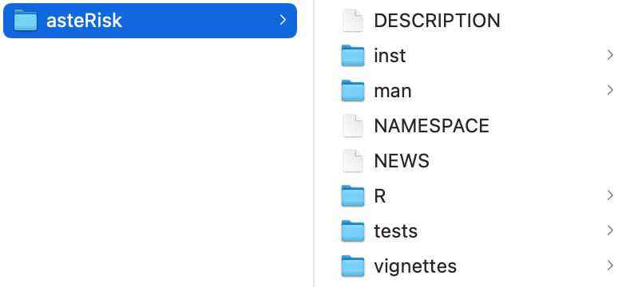
R package structure
Required files/folders:
DESCRIPTION: summary of the package/declaration of dependencies
NAMESPACE: declaration of imported/exported functions
R/*.R: folder with .R files (this is where the R code goes)
man/*.Rd: folder with .Rd files (documentation)
Highly recommended (might even be required by reviewers):
vignettes/*.Rmd: descriptive example of how to use the package
tests/*.R: unit tests – R statements that should evaluate to true
Optional:
inst/*: variety of purposes (example data files, required files, etc.)
src/*: compiled code written in other languages (e.g., C++, Java)

Slide 20
DESCRIPTION file
Contains basic information about the package
Mandatory fields:
Package: package name
Version: version of the package
Title: one sentence describing what the package does
Description: short but comprehensive paragraph about the package, possibly including citations
License: standard license or “file LICENSE” (open-source licenses, usually unrestricted)
Author + Maintainer/Authors@R: list of authors in Author field, single name + email address in Maintainer field. Alternatively, concatenation of person() calls, with one of them having “cre” role (the maintainer)

Slide 21
DESCRIPTION file
It must also declare dependencies (other packages used by your package)
Classified into several fields:
Imports: packages strictly required for the core functionalities of your package
Suggests: packages that enhance somehow functionalities of your package, but are not strictly required (e.g., higher performance, some accessory functionalities, required for vignette, etc.)
LinkingTo: packages from which C/C++ code is used

Slide 22
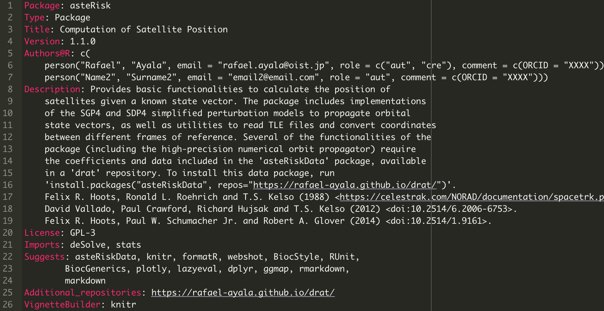
DESCRIPTION file

Slide 23
NAMESPACE file
Declares imports/exports for the package.
Imports should match DESCRIPTION Imports field
Two ways to import other packages:
import(‘package’): imports all variables declared by that package in its NAMESPACE file. Argument except(‘function1’, ’function2’) can be added for exceptions
importFrom(‘package’, ‘function1’, ‘function2’): selectively imports the specified variables
Exports are declared with export(‘variable’)
Regular expressions can be used for exports: exportPattern(‘REGEXP’)
exportPattern("^[^\\.]") will export everything that does not start with a dot
Not recommended for final version

Slide 24
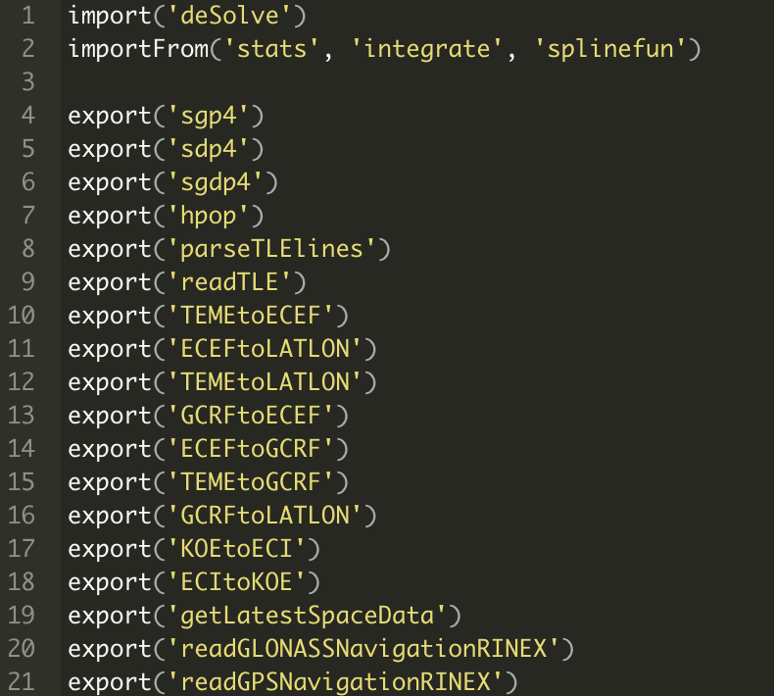
NAMESPACE file

Slide 25
NAMESPACE file
Imported variables (such as functions) can be used directly in your own code
The package to which they belong can be made explicit with the ‘::’ operator, such as importPackage::function()
Packages in Suggests are not included here. Instead, use them conditionally and access functionality with :: operator:
if (requireNamespace('package', quietly = TRUE)) { package::function() }
Triple-colon operator (‘:::’) allows accessing non-exported variables
Usually not recommended

Slide 26
R code
All files in R folder should be R scripts (most usually .R extension)
Any number of files can be included
Most frequently, these files generate R objects through assignments
Therefore, order of files/exact file where each object is defined does not matter
If computations are required for some reason, order of evaluation can be controlled through DESCRIPTION field Collate
Any organization strategy can be followed
Not recommended to put all objects into a single .R file, or to put every object into a separate .R file
It is recommended to split objects into thematic modules

Slide 27
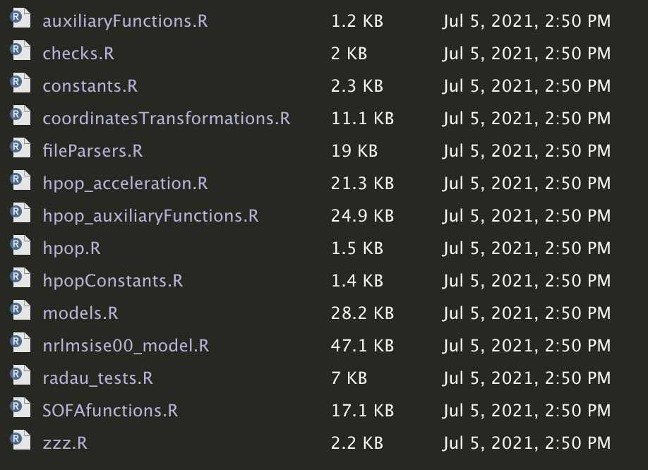
R code

Slide 28
R code
Special functions for actions when loading package:
.onLoad(libname, pkgname): runs when package is loaded
.onAttach(libname, pkgname): runs when package is attached (i.e., library(package) is called)
Inverse functions:
.onUnload(libpath)
.onDetach(libpath)
Might be required to clean-up side effects of .onLoad/.onAttach
By convention, place all of these in file called zzz.R

Slide 29
Documentation
Every exported object must have associated documentation
Documentation is provided as .Rd files in man/ folder
Employed R documentation format uses a simple markup language with many similarities to LaTeX
Multiple schemes can be used. For simplicity, one .Rd file for each export

Slide 30
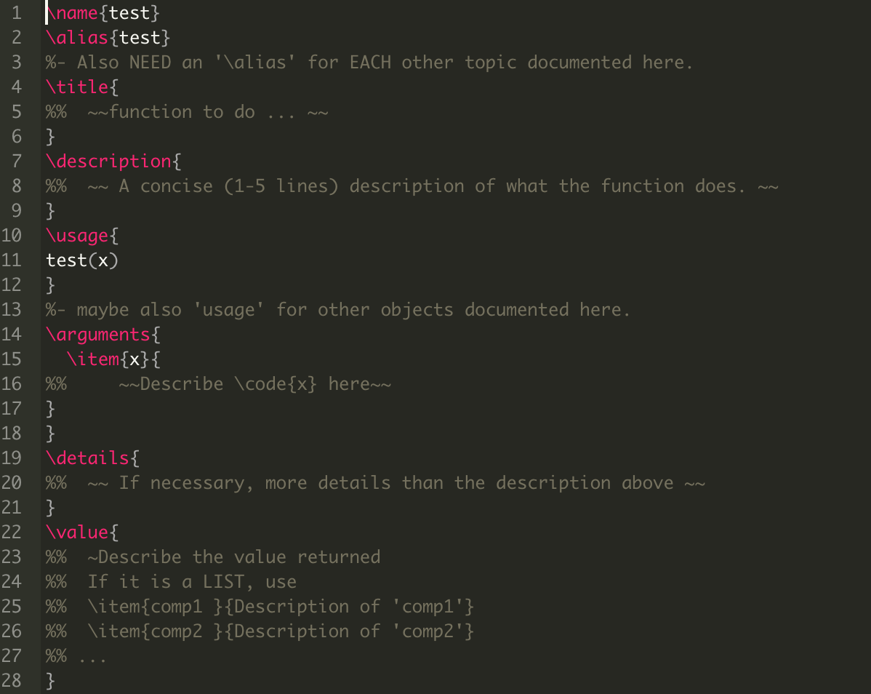
Documentation
name: object name
alias: usually same as name, but multiple objects can be specified
title: very short description of what the documented object/set of objects do
description: short paragraph describing what the object does
usage: R-like command summarizing how the object (function) is used. Should match exactly function definition (same arguments order, name and default values)
arguments: description of the arguments of the function. One “\item{x} {Description of x}” per argument
details: optional extended description
value: description of what the function returns (if function is called for side-effects, also describe it here)

Slide 31
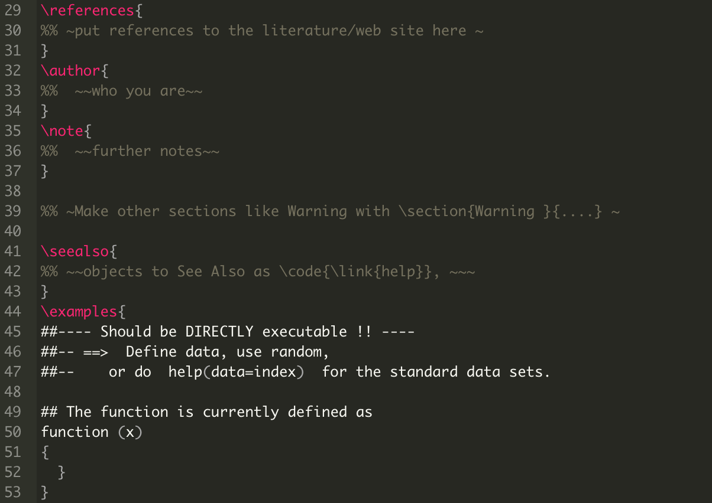
Documentation
references: literature/web references
author: author of the documented object
note: additional notes
seealso: link to the documentation of related objects. Provide as \code{\link{relatedName}} (can also be linked at other places)
examples: an illustrative, short example of application of the documented object. Every documented object should have a runnable example. For expected errors, use wrap with try() or place \dontrun{} directive around it. If absolutely required not to run example for other reasons, wrap with if(interactive()) {}

Slide 32
Vignettes
More detailed, long-form documentation of the different functionalities of the package
It usually provides an overview of the main functionalities in the form of an example application case
Resembles somewhat a short paper
One or more vignettes can be included in the vignettes/ directory
Originally, vignettes had to be written in LaTeX and compiled with Sweave (.Rnw files). This can still be done.
Now, alternative vignette engines (an interface that convert a document written in a specific markup language into HTML and PDF documents)

Slide 33
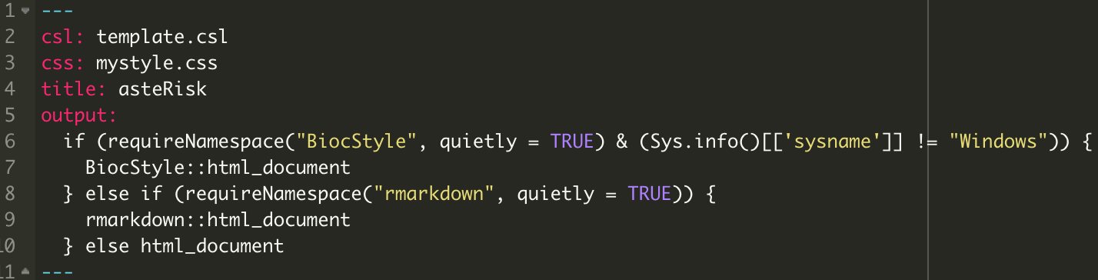
Vignettes
R Markdown from the knitr package has become very popular
Vignettes are written in markdown format (.Rmd files), which makes it easy to combine organized text with example code and results (including plots)
Document starts with a YAML header:
Specify title, style templates in CSS, citations template in CSL, output format (HTML, PDF, word). Output format can include elaborated R statements with conditionals

Slide 34
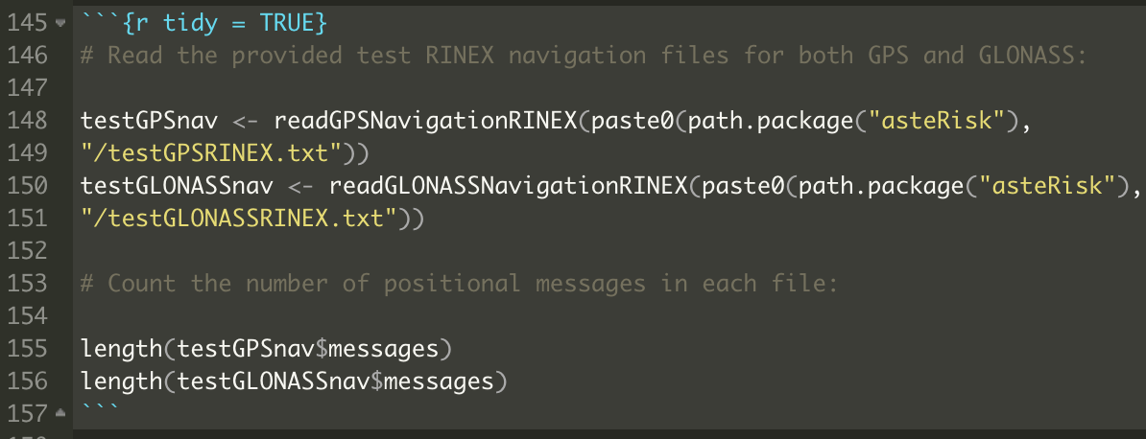
Vignettes
Markdown syntax allows sections, different font modifiers, hyperlinks, insertion of references (a separate bibtex file can be provided)
Beginning of an R code chank is marked with ```{r } and end is marked with ```. Another language instead of “r” can be specified (e.g. python)
Additional options can be provided:
include=FALSE: do not embed in vignette
echo=FALSE: embed results but not code
eval=FALSE: do not run the code
tidy=TRUE: automatically reformat code
If using knitr and R Markdown to create a vignette:
Add VignetteBuilder: knitr to DESCRIPTION file
Add rmarkdown to Suggests field in DESCRIPTION file

Slide 35
Unit tests
Set of R statements to verify continued consistency of the code
Useful to ensure that changes/additions to the package to do not lead to unexpected changes
Multiple ways to implement them. Two main ones:
RUnit
testthat

Slide 36
Unit tests with RUnit
Create tests/ folder
Place inside file called runTests with single line: “BiocGenerics:::testPackage(”package")”
Add BiocGenerics and RUnit to Suggests field of DESCRIPTION
Make unitTests/ folder within inst/ folder
Within unitTests/, add any number of .R files starting with “test” (e.g., “test_all.R”) containing the tests performed with check functions from RUnit

Slide 37
Runit check functions
Functions that will evaluate to TRUE if a condition is satisfied, and otherwise raise an ERROR
checkTrue(x): verifies that x==TRUE
checkEquals(x, y): verifies that x==y
checkIdentical(x, y): verifies that identical(x,y)==TRUE (stricter than checkEquals. For example, checkEquals(as.double(1), as.integer(1)) is fine, but checkIdentical(as.double(1), as.integer(1)) fails
checkEqualsNumeric(x, y, tolerance): verifies that two numerical values x and y do not deviate from each other by more than the specified tolerance (i.e., verifies the following: abs(x-y)/abs(x) <= tolerance && abs(x-y)/abs(y) <= tolerance ).

Slide 38
Day 1
Introduction
Mainstream repositories for R packages
Features and structure of an R package
Submitting a package to CRAN
Practical: creating a package

Slide 39
Submissions to CRAN
The package must be successfully built (i.e., all files must be successfully collated and compressed into a single .tar.gz file) and installed in at least two of the three major platforms (Windows, Linux, MacOS), ideally all platforms
Package can be built by running R CMD build (package_folder) from command line
Successful installation can be verified by running R CMD check (package_tarball)

Slide 40
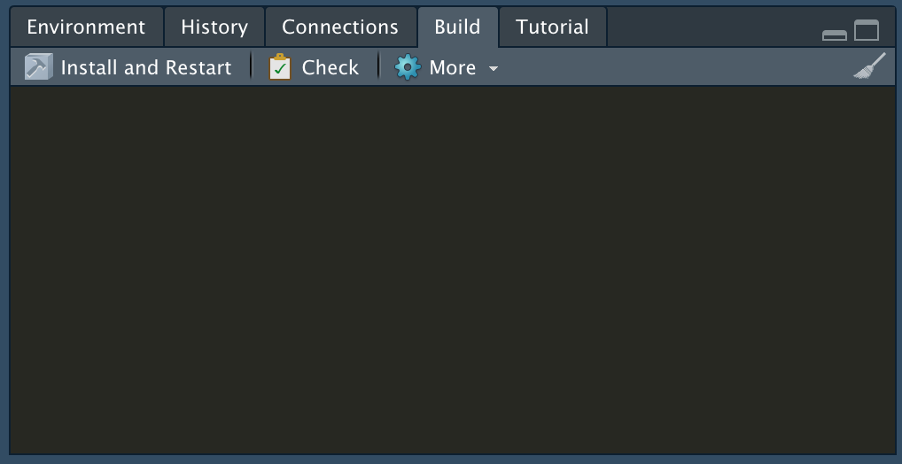
Submissions to CRAN
Both checks can be automatically performed from RStudio

Slide 41
Submissions to CRAN
Problems come in 3 levels (increasing importance): NOTE, WARNING, ERROR
No WARNINGs or ERRORs will be accepted, and only exceptionally NOTEs will be allowed
CRAN performs some additional checks compared to standard R CMD check
Can be replicated locally by adding --as-cran argument to R CMD check
RStudio can be configured to have additional parameters to R CMD check

Slide 42
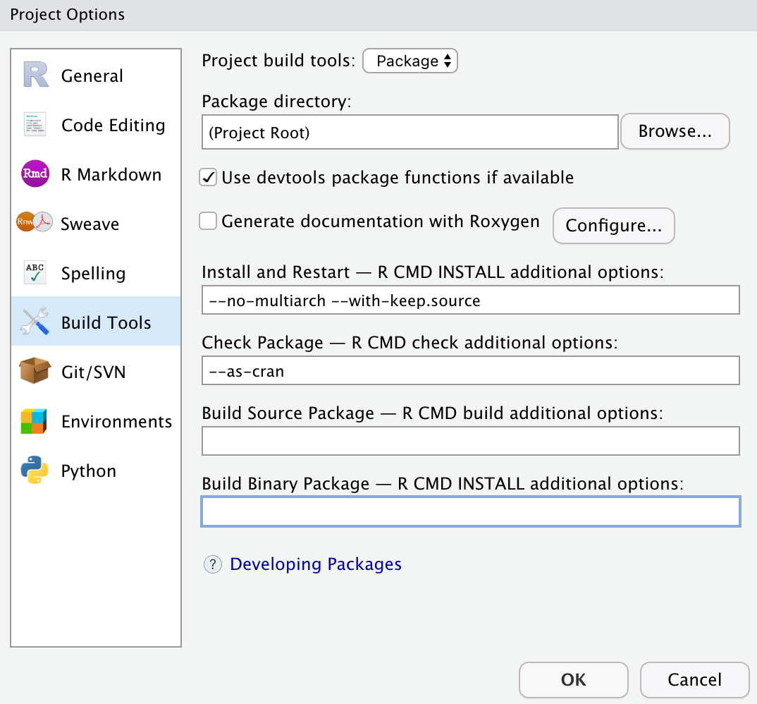
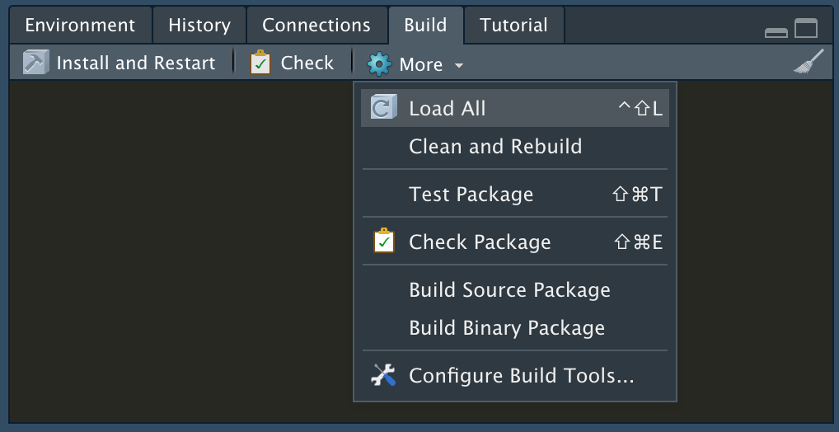
Submissions to CRAN

Slide 43
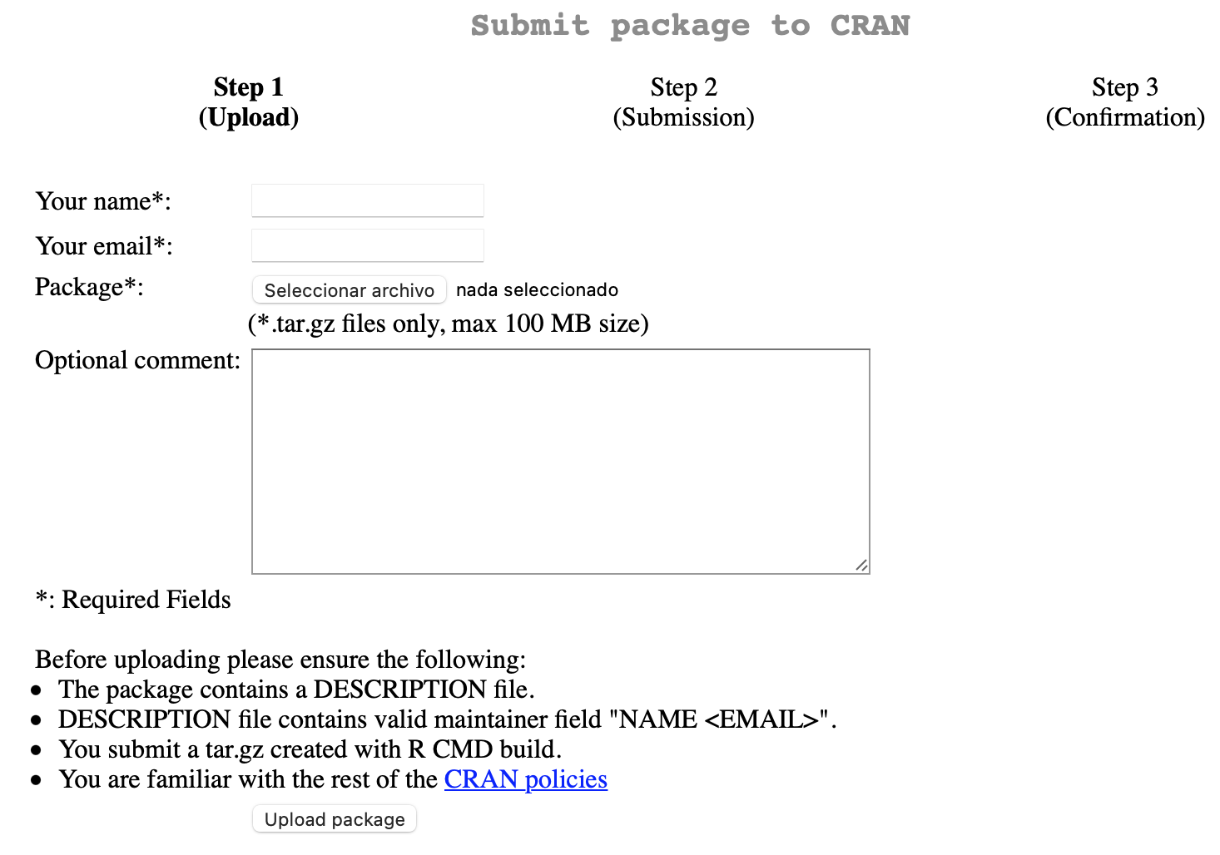
Submissions to CRAN
If no Windows machine is available: https://win-builder.r-project.org
After successful R CMD check --as-cran is achieved, submit the .tar.gz tarball as generated by R CMD build through https://cran.r-project.org/submit.html
Include brief description in Optional comment field

Slide 44
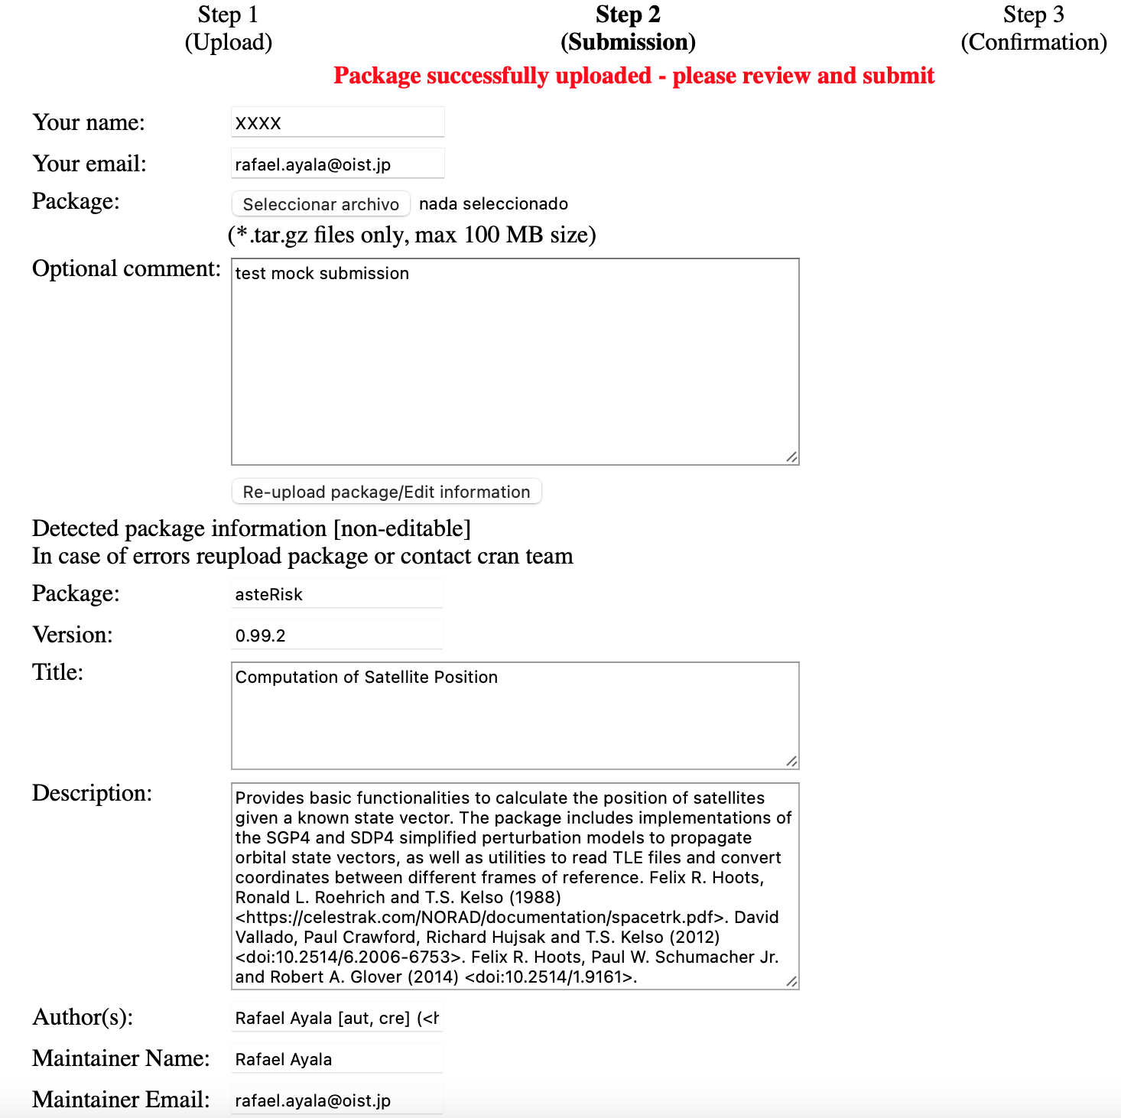
Submissions to CRAN
Review information automatically retrieved from DESCRIPTION file

Slide 45
Submissions to CRAN
Confirm submission in confirmation email
A reviewer will be assigned. Modifications to the package might be requested
A revised version should be submitted following the same procedure, specifying changes in the Optional comments field
Make sure to read and strictly follow CRAN policies https://cran.r-project.org/submit.html
Any version numbering scheme can be followed
Following Bioconductor procedure: 0.99.0 for initial submission, 1.0.0 for next version
New versions of the package (including new features, bug fixes or changes requested by CRAN team) are submitted through the same procedure
New versions must have a bump in version number. No strict requirements (usually, increase by 1 second number, or first number for very large updates)

Slide 46
Day 1
Introduction
Mainstream repositories for R packages
Features and structure of an R package
Submitting a package to CRAN
Practical: creating a package

Slide 47
Creating a test package
Start a new project of package type in Rstudio
Write a function in R folder
Modify DESCRIPTION file
Build and install package
Add a new function and do not Export it through NAMESPACE
Build and install, try to use the new function. Test ::: operator
Run R CMD check --as-cran on package
Check errors/warnings
Write .Rd files for the exported functions
Add a vignette to the package

